Slide 1
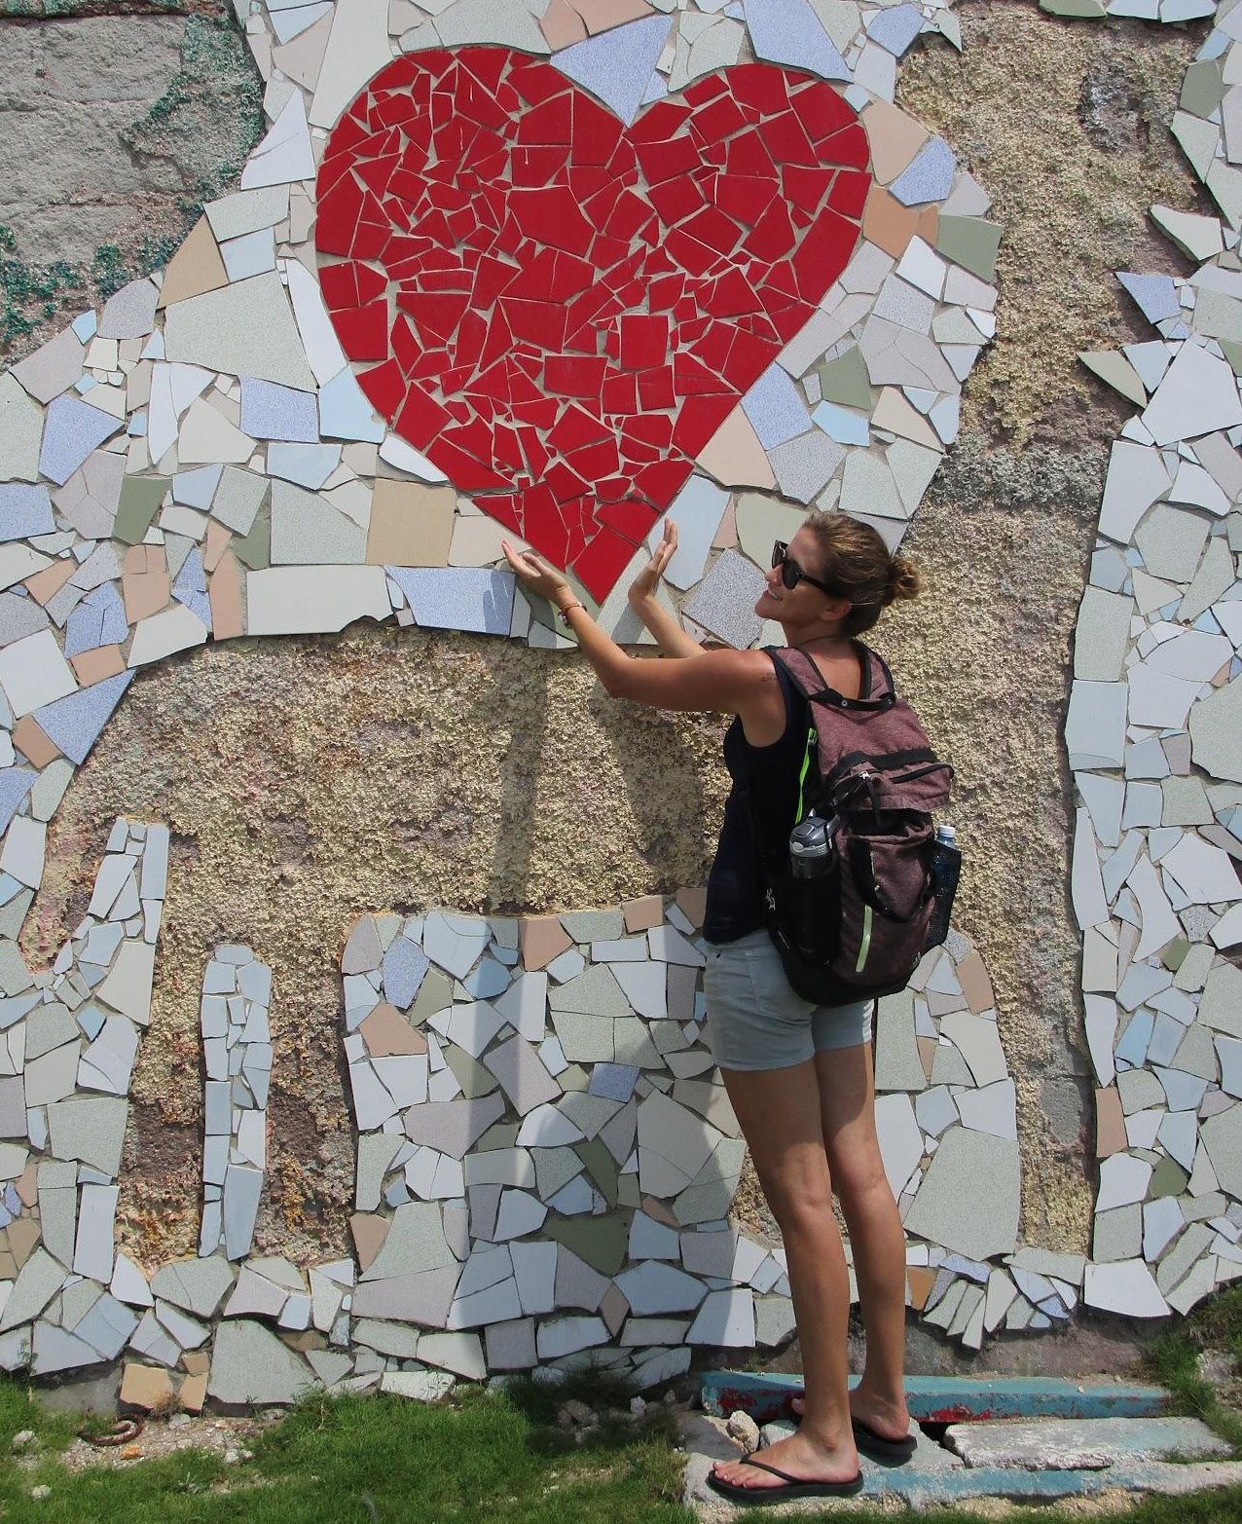
About Me
PERU 2021
Ms. Karlee Michel
7 years total at Westerville North (2 traveling North/Central)
Spanish Teacher/International & Spanish Club Advisor/Cross Country Asst. Coach
Belize, Costa Rica, Cuba, Canada, Uruguay/Argentina (2020)
Notes:
First just a little about me…
I’m excited to offer this trip because…
Thanks for coming to learn about this exciting opportunity for your child to travel abroad

Slide 2
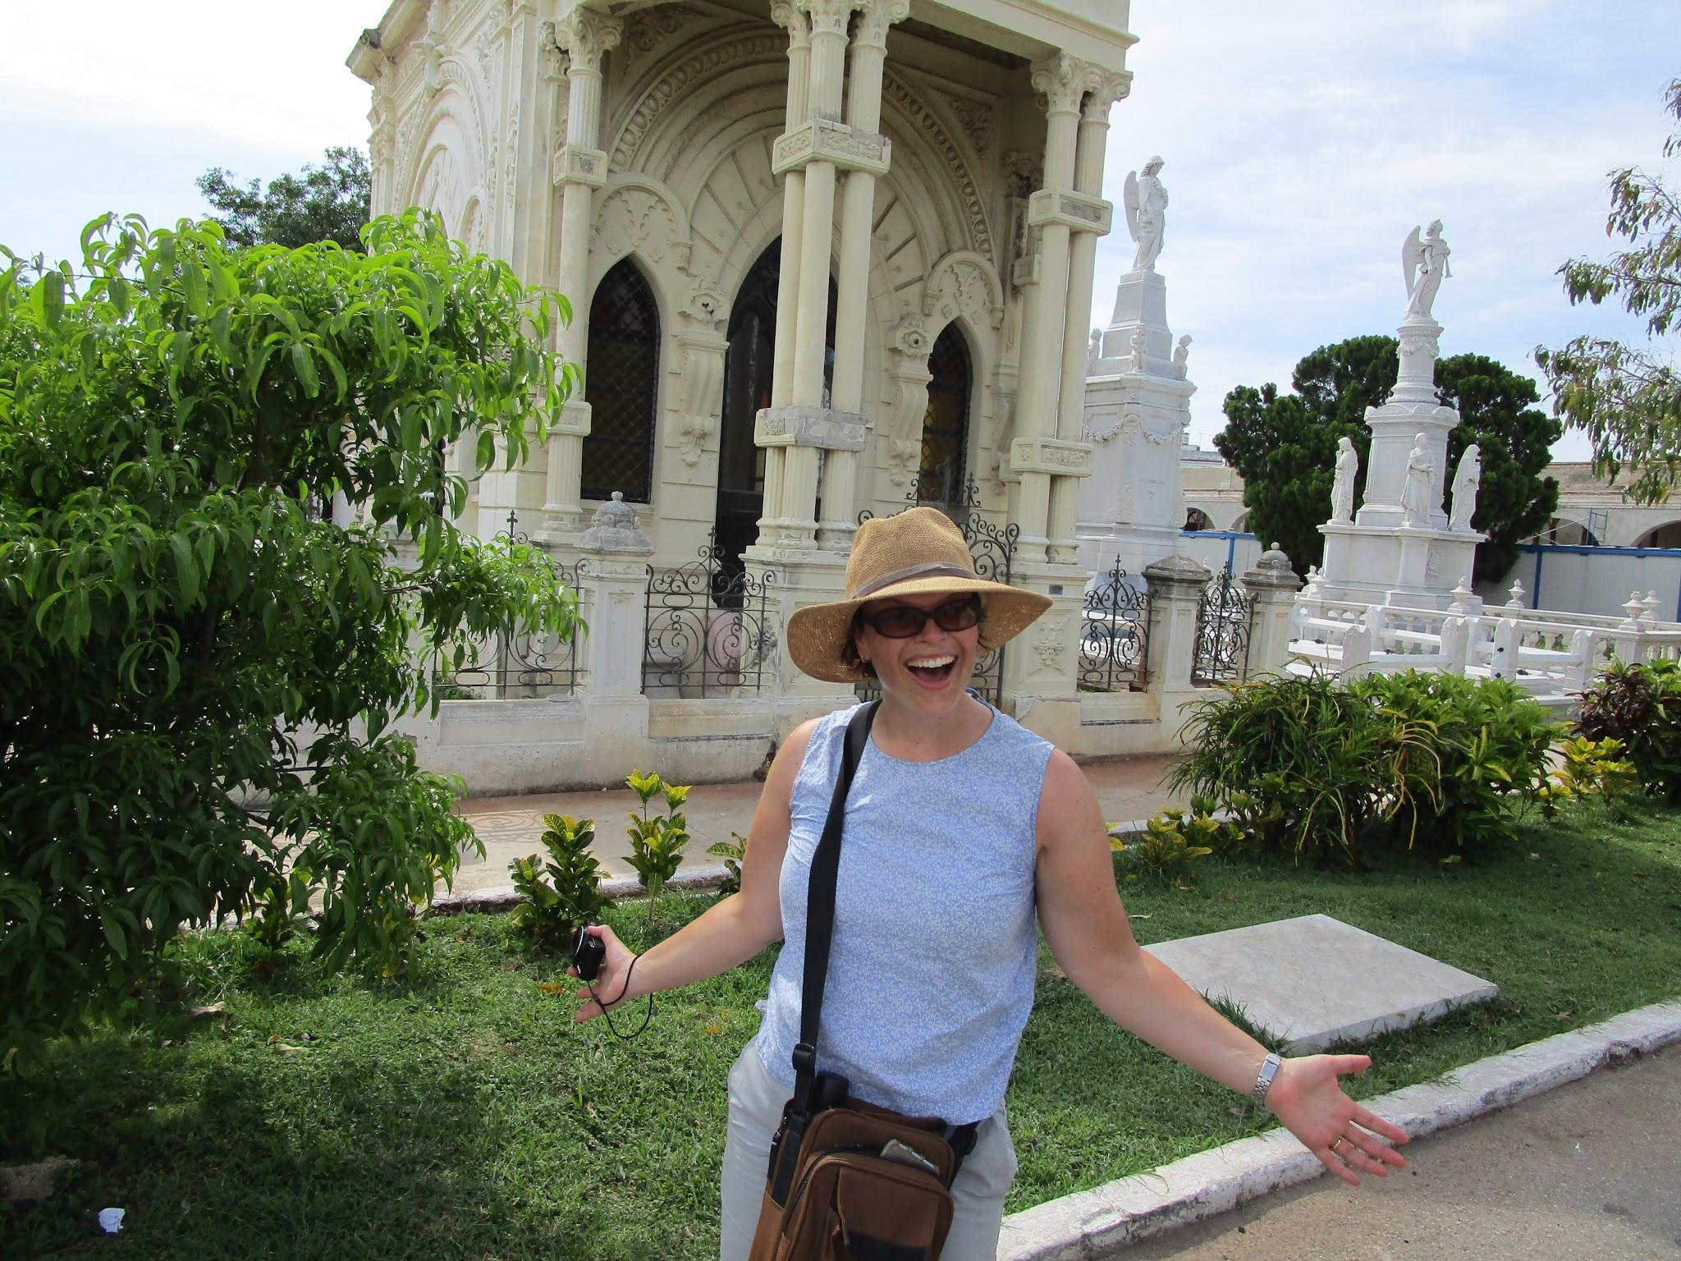
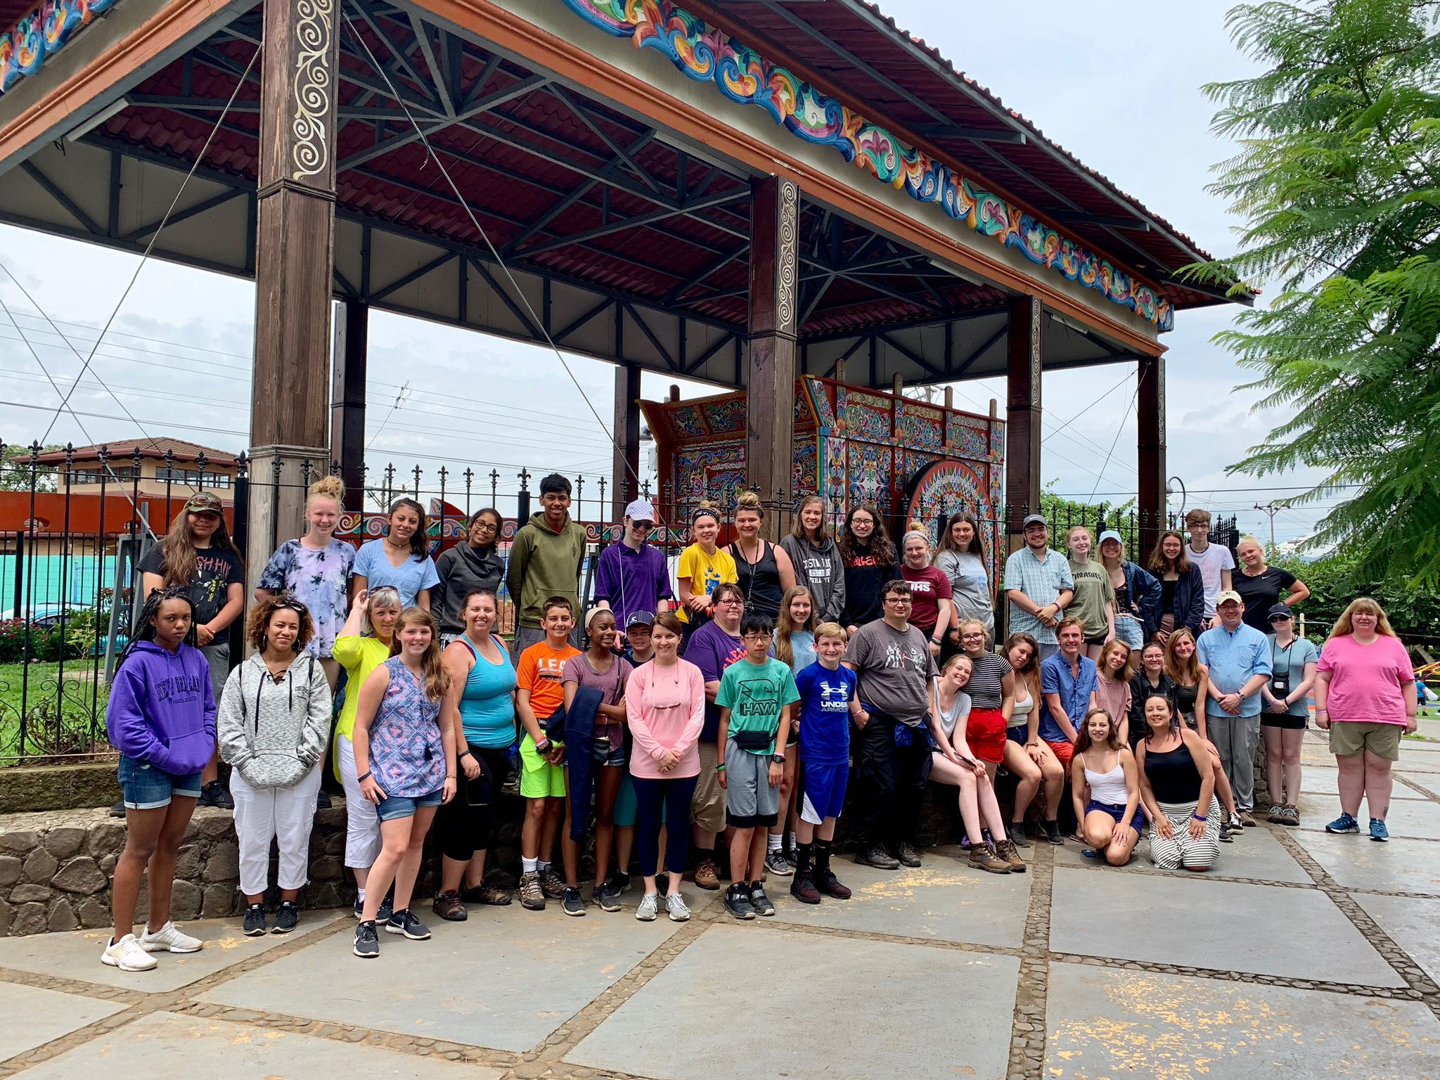
Our amazing
co-leaders!
Erin Moehl (Central High School)
Spain (2x), France, Italy, Dominican Republic (3x), Mexico (2x), Cuba, Puerto Rico, Costa Rica, Canada (5x)
Marisol Salcedo (North and South HS)
México (5x), Costa Rica (2x), Spain, Panamá, France, Canada
Notes:
We’re lucky to be traveling along with…

Slide 3
Our requested travel dates are July 7th 2021-July 15th 2021
Notes:
The dates above are our travel window. Block off these days in your family schedule.
We’ll be leaving as early as the date referenced above and returning as late as the date reference above.
We’ll know our set dates 3-4 months before tour

Slide 4
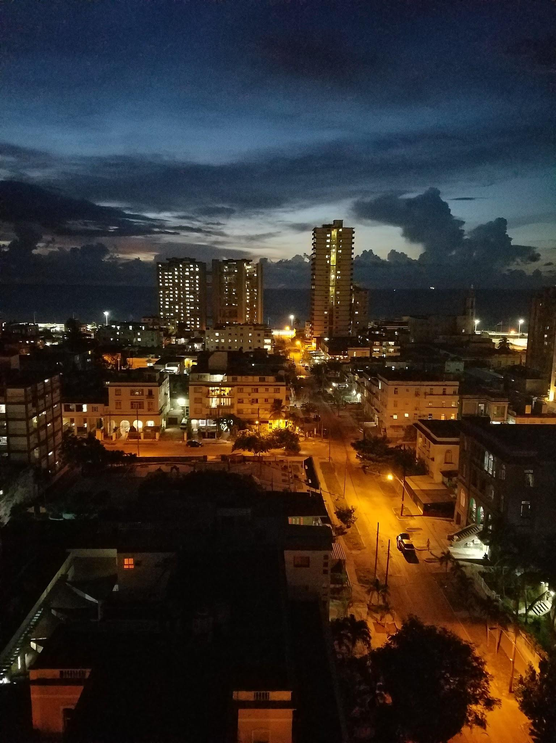
EF Educational Tours
Our travel partner
World leader in international education
50+ years of experience
500 schools & offices in 53 countries
Accredited, just like a school!
Guaranteed lowest price
Notes:
We won’t be planning this alone. We are working with EF Educational Tours, who has been doing this for over 50 years and has offices and schools all around the world. So they’ve got us covered!

Slide 5
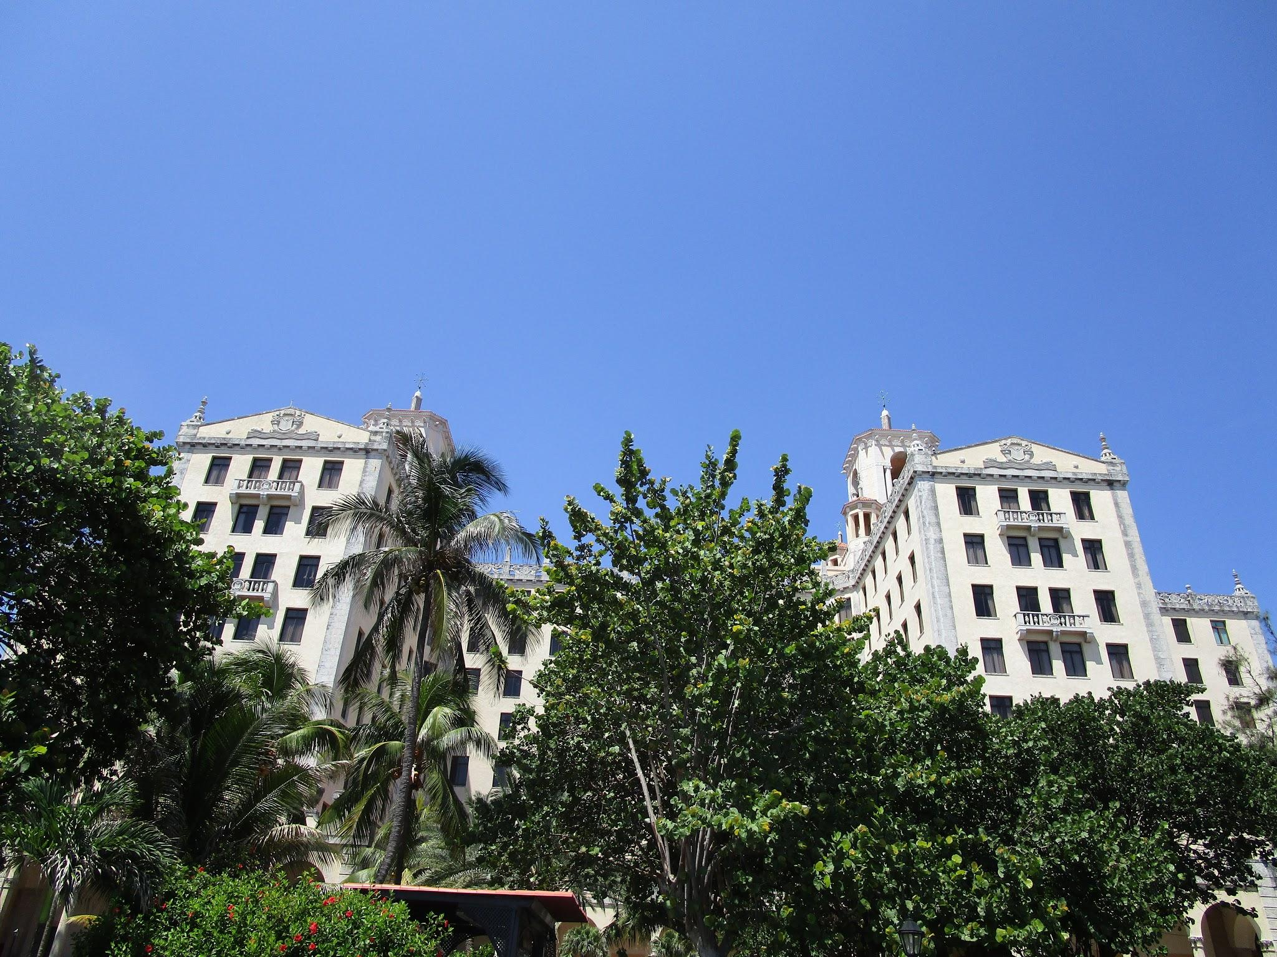
Let’s talk safety
We’ve got you covered!
EF provides our group with
24/7 Tour Director
Local presence (EF office in Lima, Peru)
24-hour emergency line
Peace of Mind Policy
Support for my safety policies
Notes:
EF Safety
Local and global presence
Chaperone to Student Ratio, every six students we will have chaperone from our school
Peace of Mind-EF will never send the group to a location they do not feel safe traveling so we have options to fall back on, if needed.
My Safety Policy/ My expectations
No drinking or drugs
This is an extension of the classroom. We are here to learn but we will have a blast while doing it.
Keep in mind-You are representing your school, state and country

Slide 6
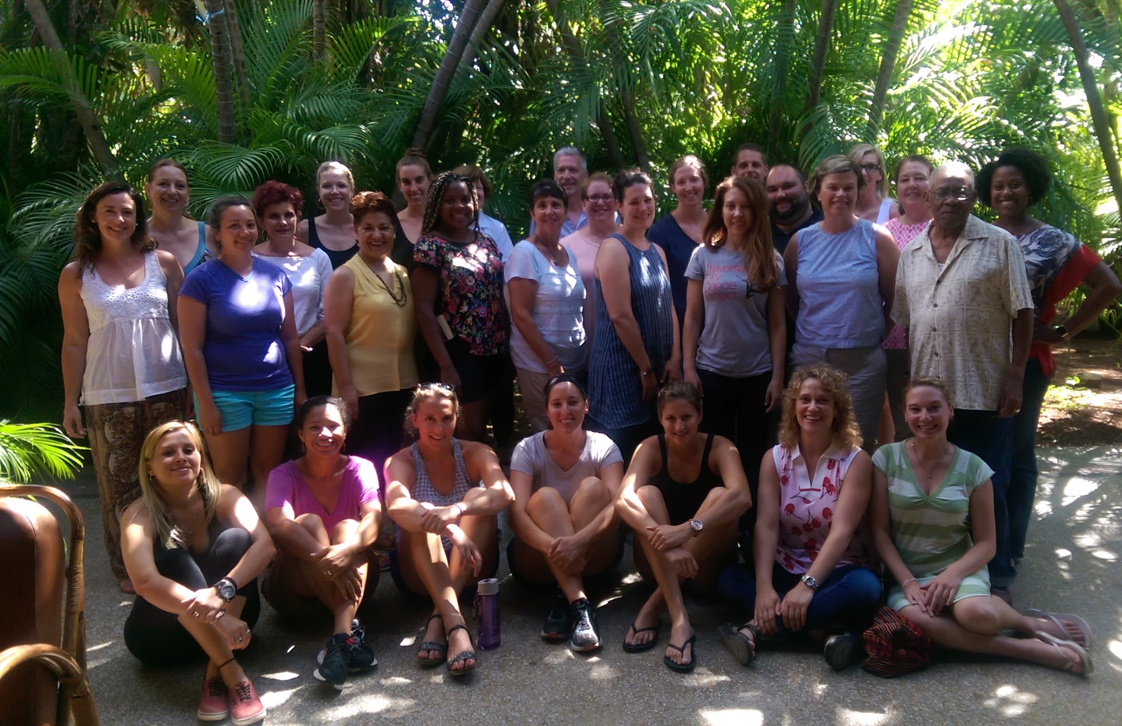
Group Travel
Meet students from around the country
Keeps our tour affordable
Allows more students to see the world
Make lasting friendships
Tour and departure flexibility match us with other groups
Notes:
So what is group travel?
It means our group may join another group of students, and we experience the trip together.
This is great because
1) It allows our students to meet others from around the country
2) Helps to keep the programs affordable (same price no matter how many enroll)

Slide 7
Educational Resources
Preparing for life after high school
HIGH SCHOOL CREDIT
COLLEGE CREDIT
COLLEGE APPLICATIONS
Earn credit
with a personal
project
Do college-level work and earn 3 credits
Use your tour to inspire your personal essay
Notes:
Whether you are thinking about it now or not, this opportunity will be something that you will be able to use and reflect on for years to come.
The great news is that this experience will be extremely educational. Students will be able to do a project around their tour experience, and if they want to take it to the next level there are three ways they can do that:
1) Option of earning FREE high school credit: EF is accredited just like our school
2) Option of earning 3 college credits through a course from Southern New Hampshire University.
The course is $215 and the credits are fully transferable (which is an amazing deal).
3) The Uncommon App is a tool to help our students structure their college personal essay question
I have additional resources on this so come see my after or make a note on your exit ticket if you are interested.

Slide 8
Our Itinerary
What we’ll see, do, and experience
What are
you excited
about?
Notes:
Now let’s talk about our tour!
Directions: Hand out the Itinerary
Take the next minute to look at the itinerary I just handed out As you can see it’s action packed. I could go through each day, minute by minute, but as I mentioned in the beginning I want to be respectful of your time. So I picked out a few of sites that I’m most excited for the students to see. We will take a peek at those in just a minute.
Directions: Ask a couple students what resonates with them

Slide 9
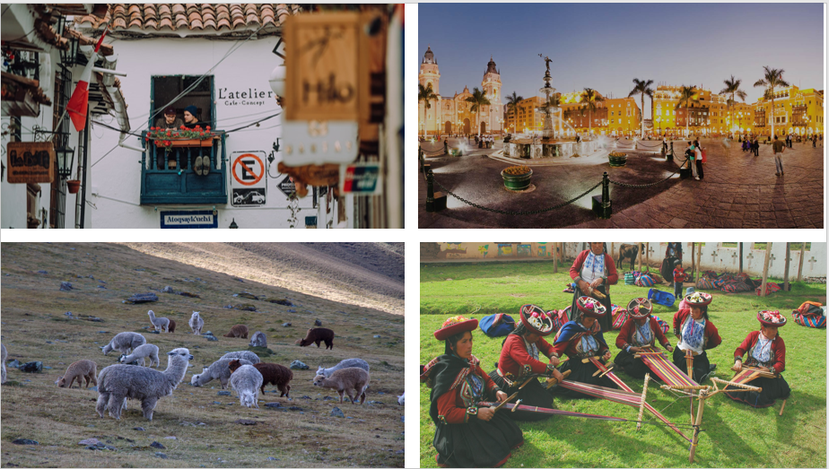
CUZCO, PERU
LIMA, PERU
SACRED VALLEY
OLLANTAYTAMBO
Notes:
Check out some of the amazing places we get to go! We’re going to see ___

Slide 10
HIGHLIGHTS
Tour Machu Picchu
Visit the Larco Herrera Museum
Visit the San Francisco Monastery
Take a walking tour of Miraflores
Enjoy a weaving demonstration
Take a walking tour of a local market and compete in a scavenger hunt
Notes:
I’m particularly excited about _____ because _______

Slide 11
It’s more than an itinerary
Travelers have said…
Notes:
This is a great opportunity to
Talk about a previous traveler’s experience/transformation
Have a previous traveler speak at the meeting about their experience
Talk about your experience in travel & how it has impacted you
EF Educational Tours focuses on a well-rounded educational experience for it’s travelers.
Of course students see places in real time that they’ve only seen in textbooks and movies.
They learn about differences in cultures and languages and regions.
This tour will help students learn more about their own interests, passions, and abilities, and even help them grow more mature.
They learn just as much about themselves as they do about the places they visit. It gets them ready for their futures.

Slide 12
What’s Included
Round-trip airfare
Safe, quality hotel rooms
24/7 bilingual Tour Director
On-tour transportation
Educational itinerary
Guided tours and activities
Breakfast and dinner daily
weShare online education platform
UnCommon App college essay toolkit
Travel backpack
24/7 on-tour assistance
Traveler Support Team
Tour Donation Page
Global Travel Protection
Notes:
So, what’s included? Pretty much everything. Directions: read through each one.
Not included: A few things. But no real surprises here. Once everyone is signed up I will hold a separate meeting for that student group to talk through all of these.

Slide 13
A few things you’re responsible for:
Passport and visa fees
Checked bag fees
Lunches and snacks
Spending money
Tips
*We’ll have a separate meeting for these things at a later date!
Notes:
So, what’s included? Pretty much everything. Directions: read through each one.
Not included: A few things. But no real surprises here. Once everyone is signed up I will hold a separate meeting for that student group to talk through all of these.

Slide 14
Making it Happen
September | 2019 | $95 deposit
September | 2019 | $170
October | 2019 | $170
November | 2019 | $170
December | 2019 | $170
January | 2020 | $170
February | 2020 | $170
March | 2020 | $170
April | 2020 | $170
May | 2020 | $170
June | 2020 | $170
July | 2020 | $170
August | 2020 | $170
September | 2020 | $170
October | 2020 | $170
November | 2020 | $170
December | 2020 | $170
January | 2020 | $170
February | 2020 | $170
March | 2020 | $170
April | 2020 | $170
May | 2020 | $170
Total Student Cost |  | $3,660
Total Adult Cost |  | $4,110 or $195/Mo
Notes:
So, what’s included? Pretty much everything. Directions: read through each one.
Not included: A few things. But no real surprises here. Once everyone is signed up I will hold a separate meeting for that student group to talk through all of these.

Slide 15
Notes:
So on to the next important topic. The price of the program.
You will see, we have lots of options and you can pick what works best for your family!
bi-weekly, monthly, or pay in full. If none of these work, give EF a call to talk about payment options.
You can also send out your tour donation page, so family and friends can donate towards your trip
I have some more materials here at the front that go into these plans in more detail

Slide 16
Why EF?
Roundtrip Flight $1,500
Hotel $700 for 7 nights (Cheapest)
Food (3 meals/day for 7 days) $300
Private Driver to/from Excursions/Hotels $1,330
Flight to Cusco (Machu Picchu) $300
Train to Ollantaytambo from Cusco: $56
Flight to Lima from Cusco $132
Train from Ollantaytambo to Aguas Calientes: $56
Transportation from Pisac to Cusco and back: $20
Machu Picchu Entrance Fee/Tour $120
Guided Sacsayhuaman Fortress tour: $120
Guided Korikancha Temple tour price: $120
Guided San Francisco Monastery Tour: $120
Guided Tour of Lima $120
Larco Herrera Museum price $11.50
Estimated Total to do the same trip on your own: $5,005.50
EF Student Program Price: $3,660
Notes:
So, what’s included? Pretty much everything. Directions: read through each one.
Not included: A few things. But no real surprises here. Once everyone is signed up I will hold a separate meeting for that student group to talk through all of these.

Slide 17
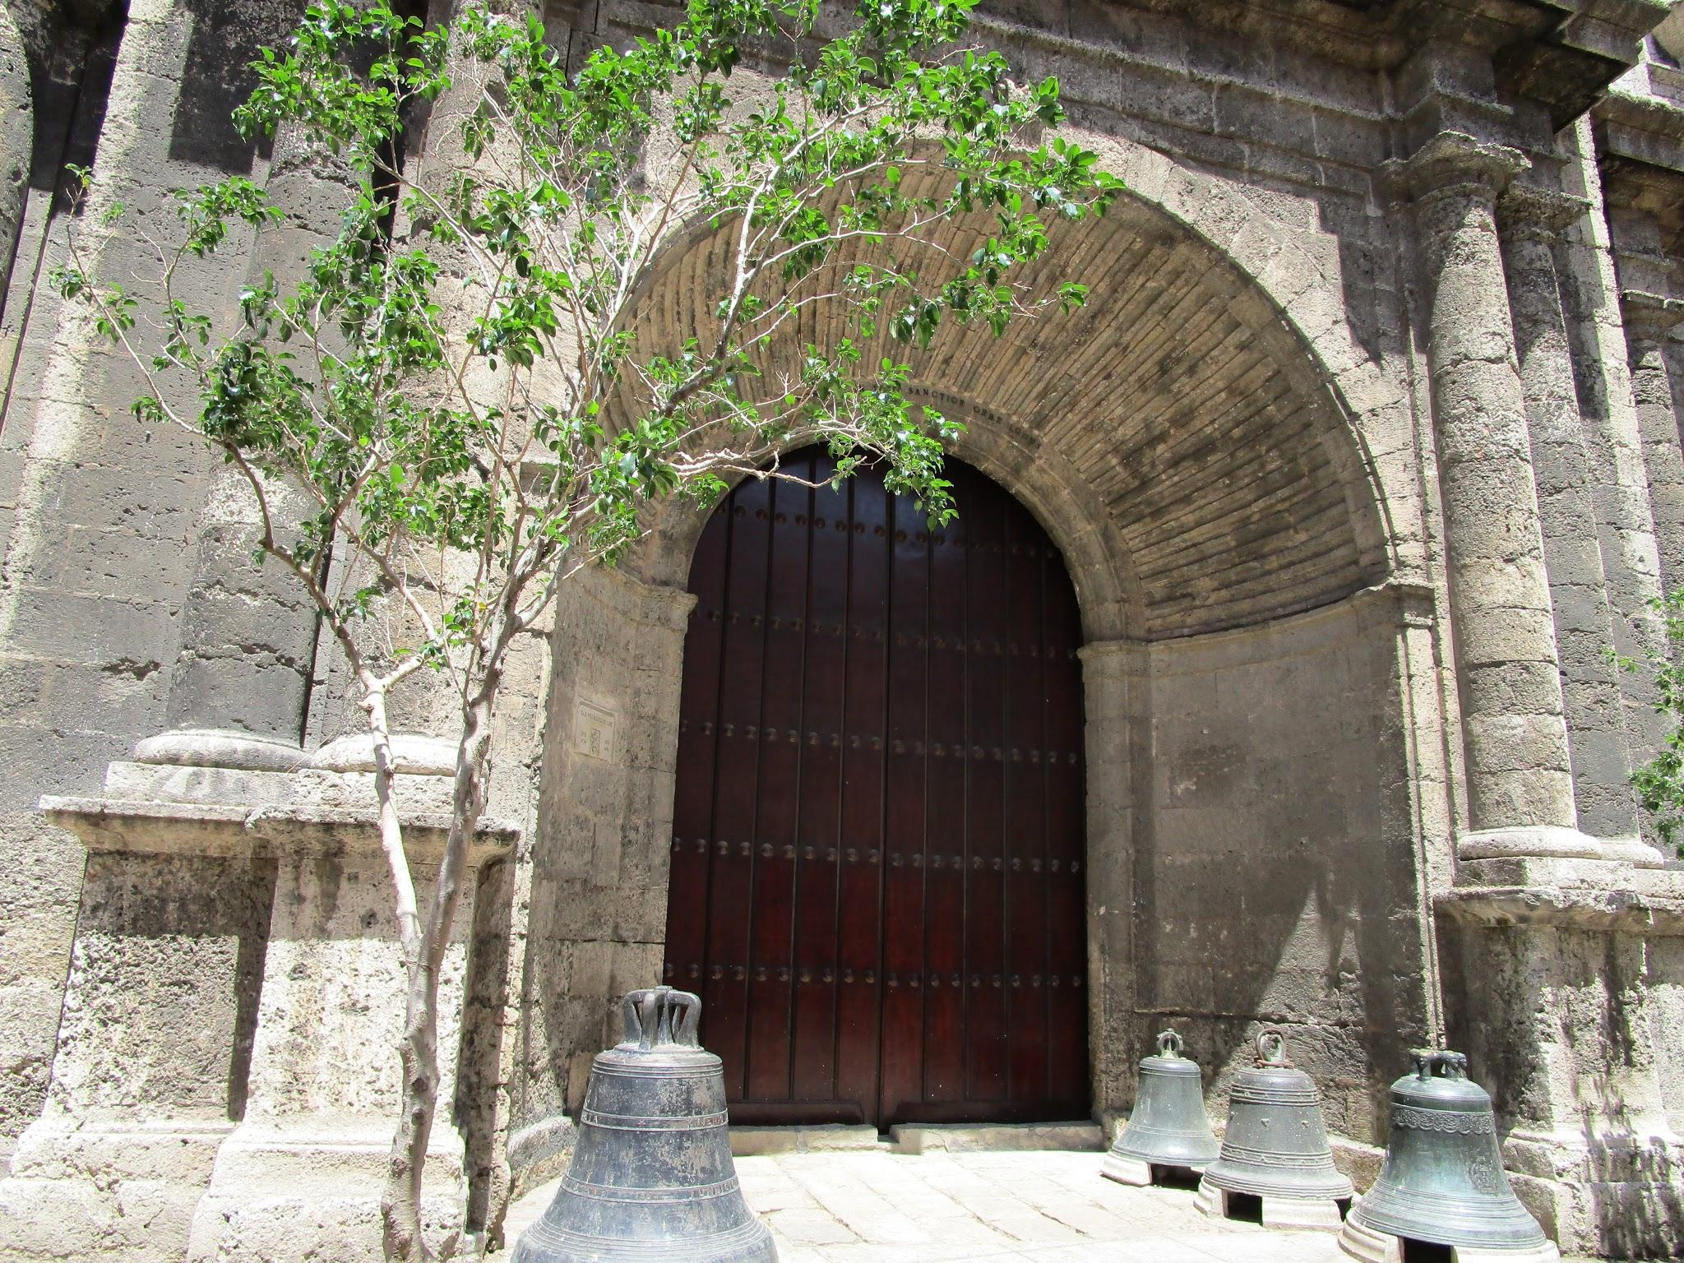
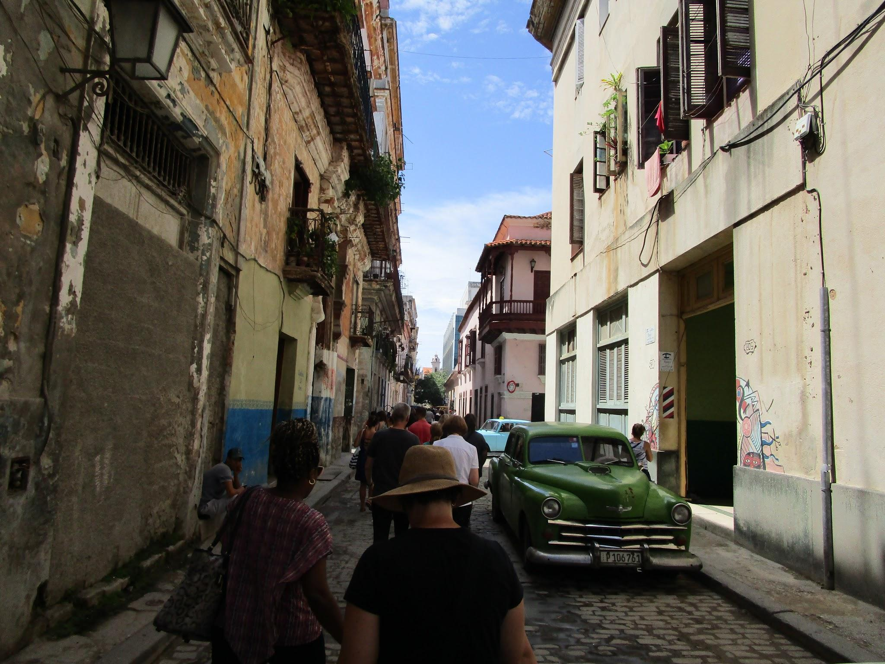
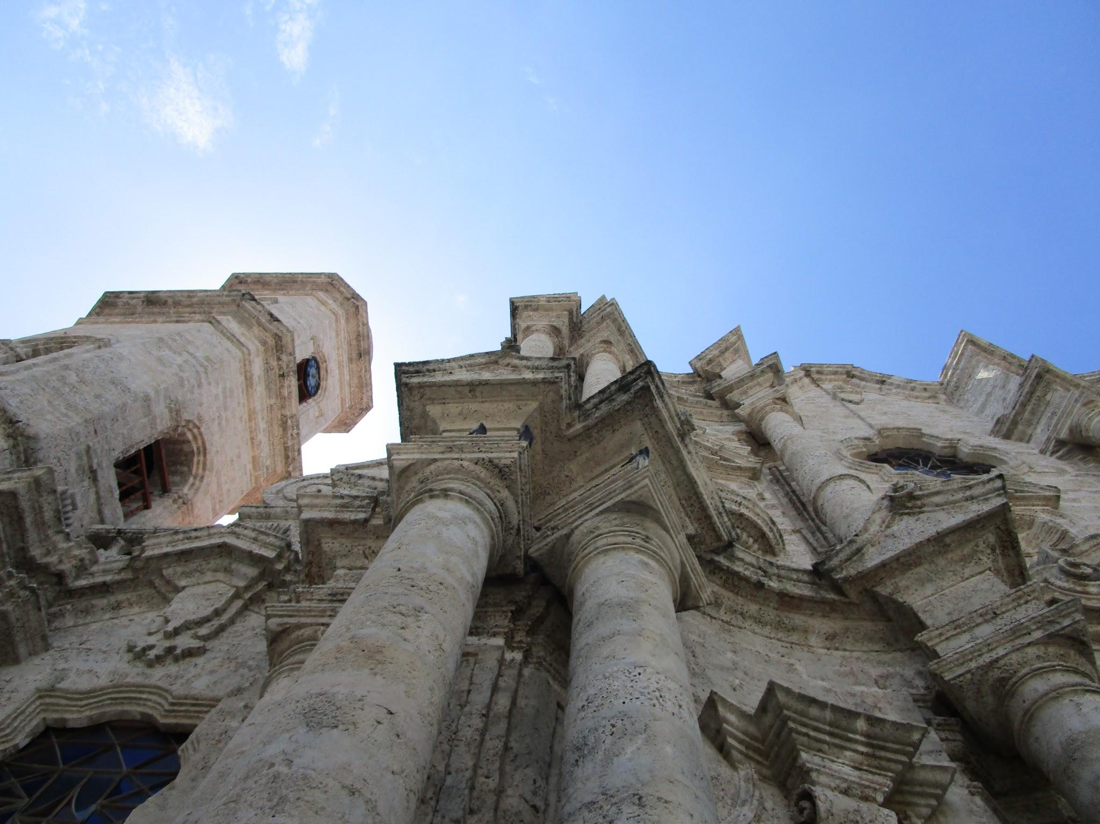
Have Questions? Who to call: 800-665-5364
From now through the tour our trusty Traveler Support Team are your go-to people!
What can they help with?
Trip Payments
Insurance Coverage
Tour Activity Questions
Account Questions
Enrolling your child on the trip
They can help you with any question you may have, don’t be afraid to reach out!

Slide 18
Contact me with questions!
Karlee Michel
michelk@wcsoh.org
Thanks for coming and have a great night!

