Slide 1
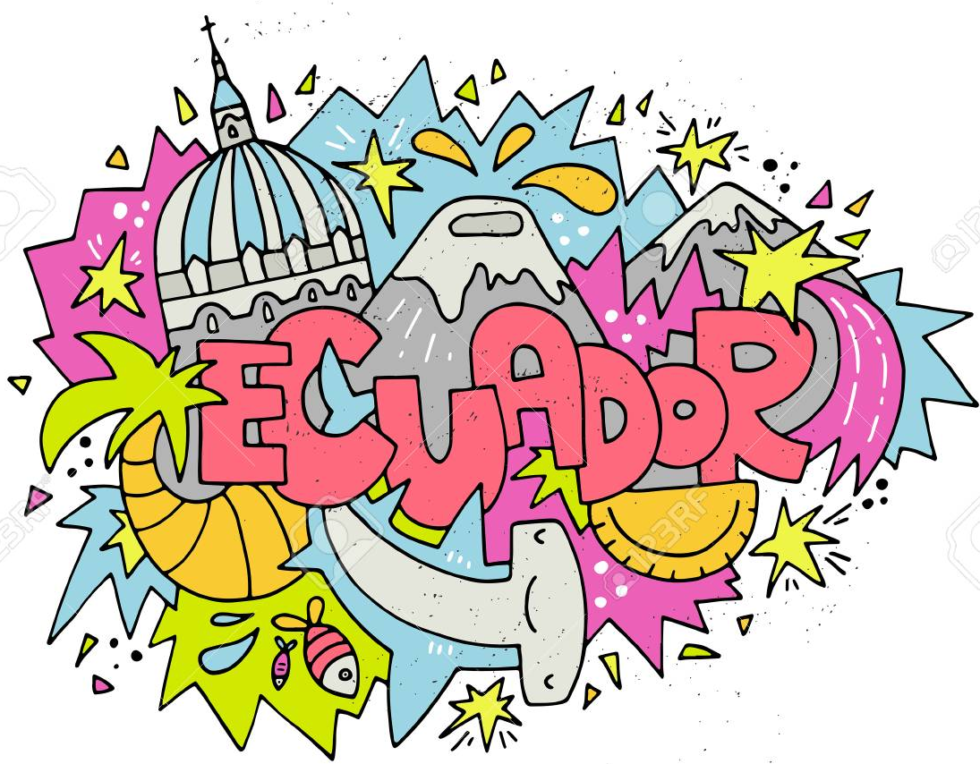

Slide 2
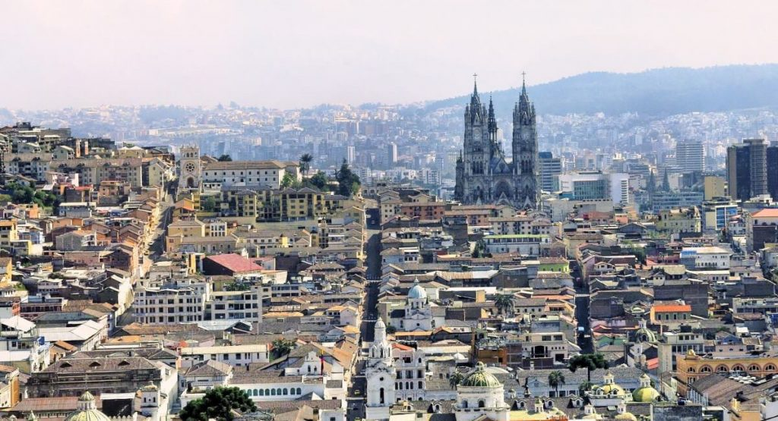
Capital of Ecuador
Quito

Slide 3
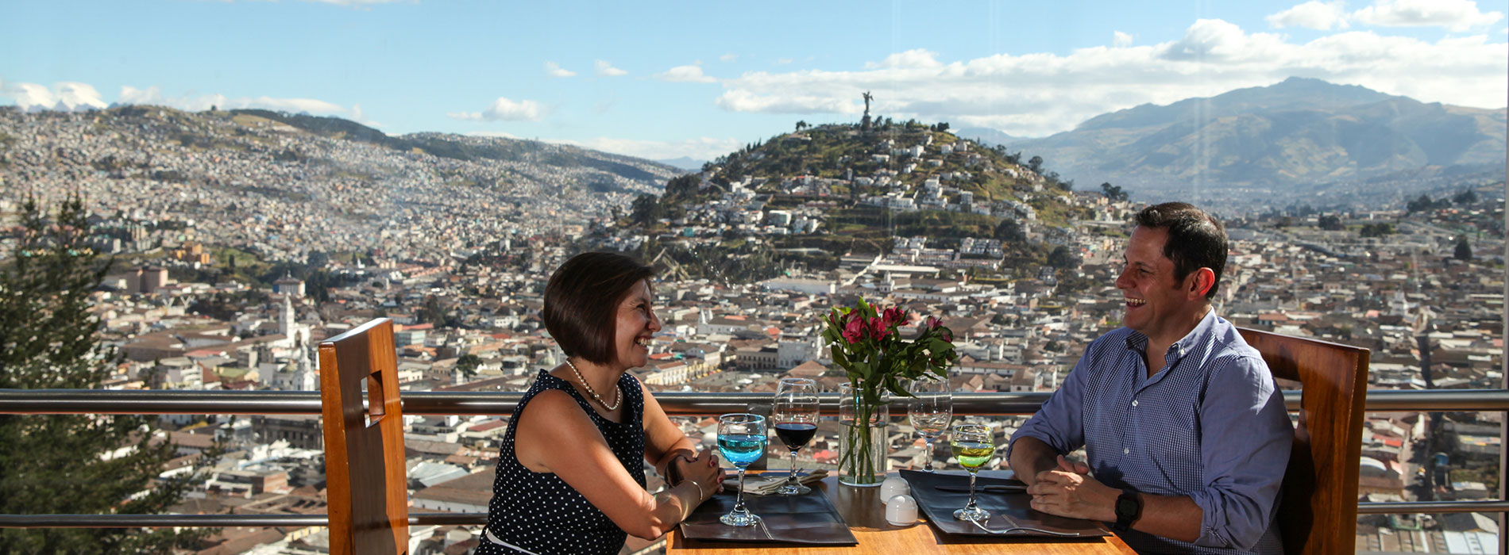
Sea Level of Quito
9,350 above Sea Level

Slide 4
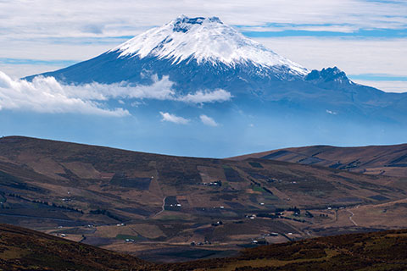
Cotopaxi
Active Volcano

Slide 5
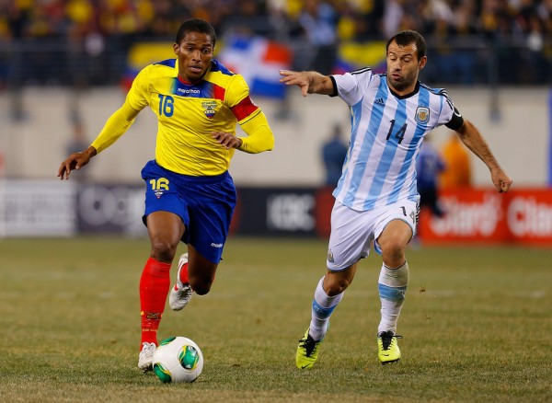
Official Sport
Soccer/Fútbol

Slide 6
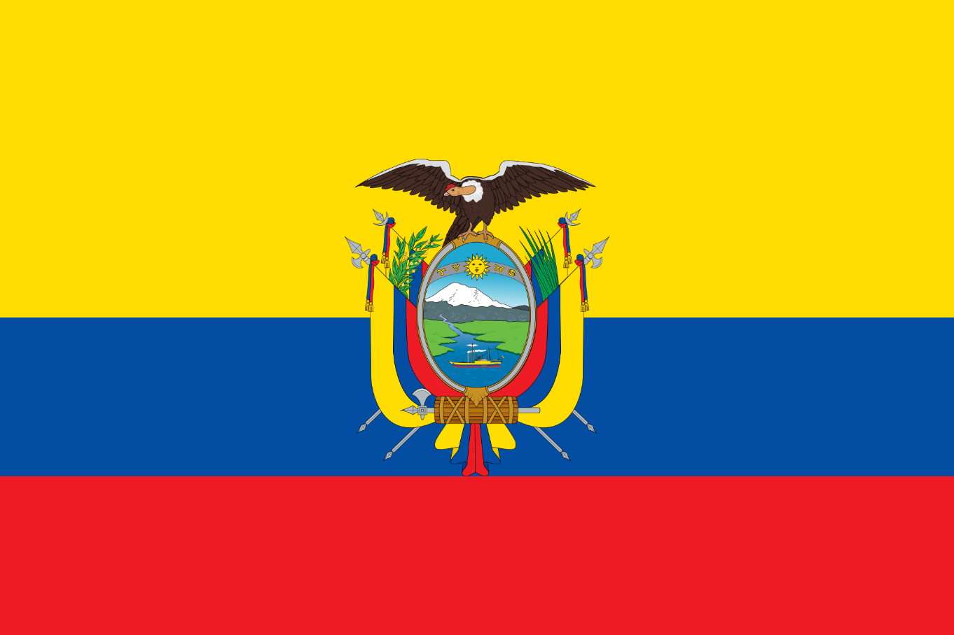
Flag Colors
Red: blood of soldiers
Blue: sea/sky
Yellow: land/crops

Slide 7
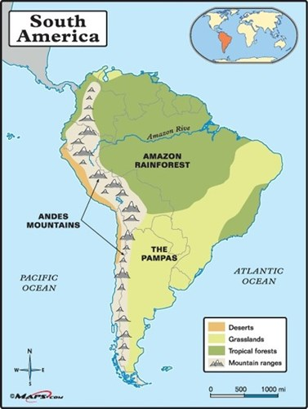
Mountain Range:
The Andes

Slide 8
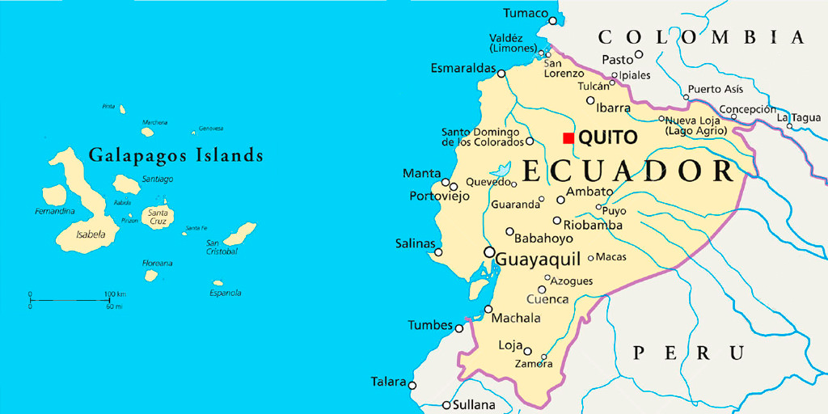
Galapagos Islands
About 600 miles

Slide 9
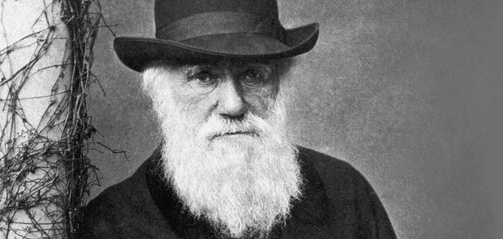
Naturalist:
Charles Darwin

Slide 10
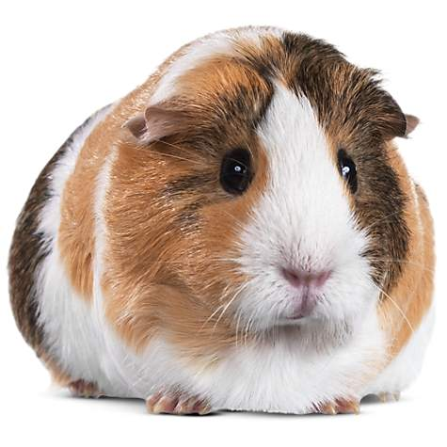
Cuy =
Guinea Pig

Slide 11
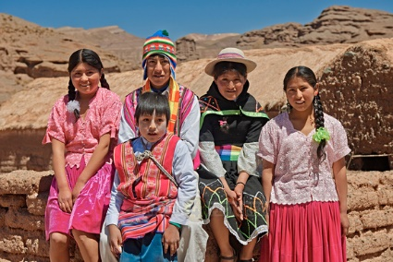
Quechua =
Native Language

Slide 12
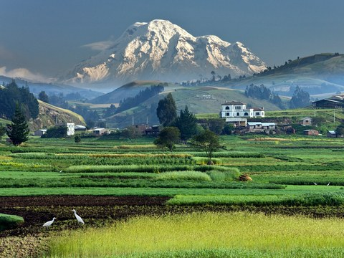
Closest to the sun:
Mount Chimborizo

Slide 13
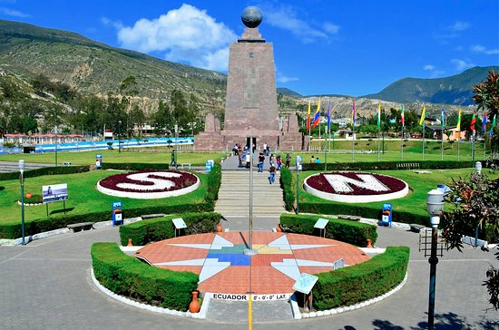
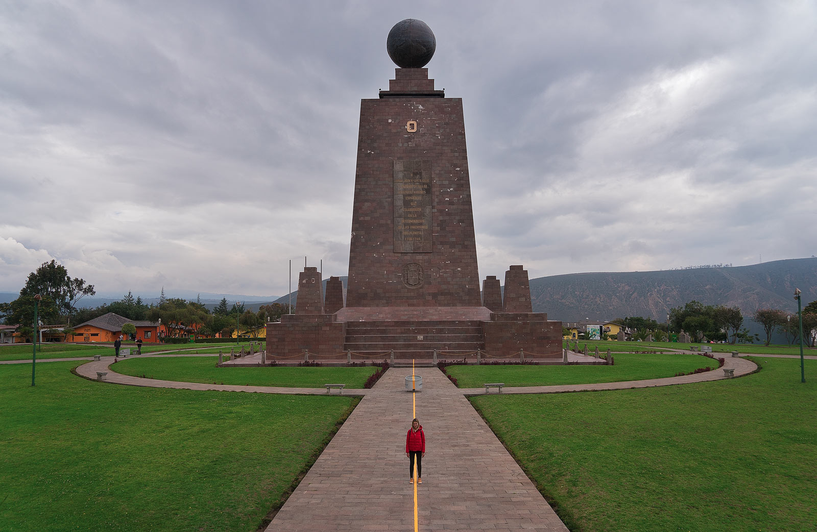
El Mitad del Mundo
Middle of the World:
Monument of the Equator

Slide 14
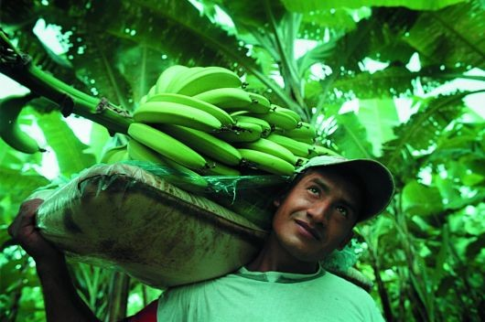
Biggest export
Bananas

Slide 15
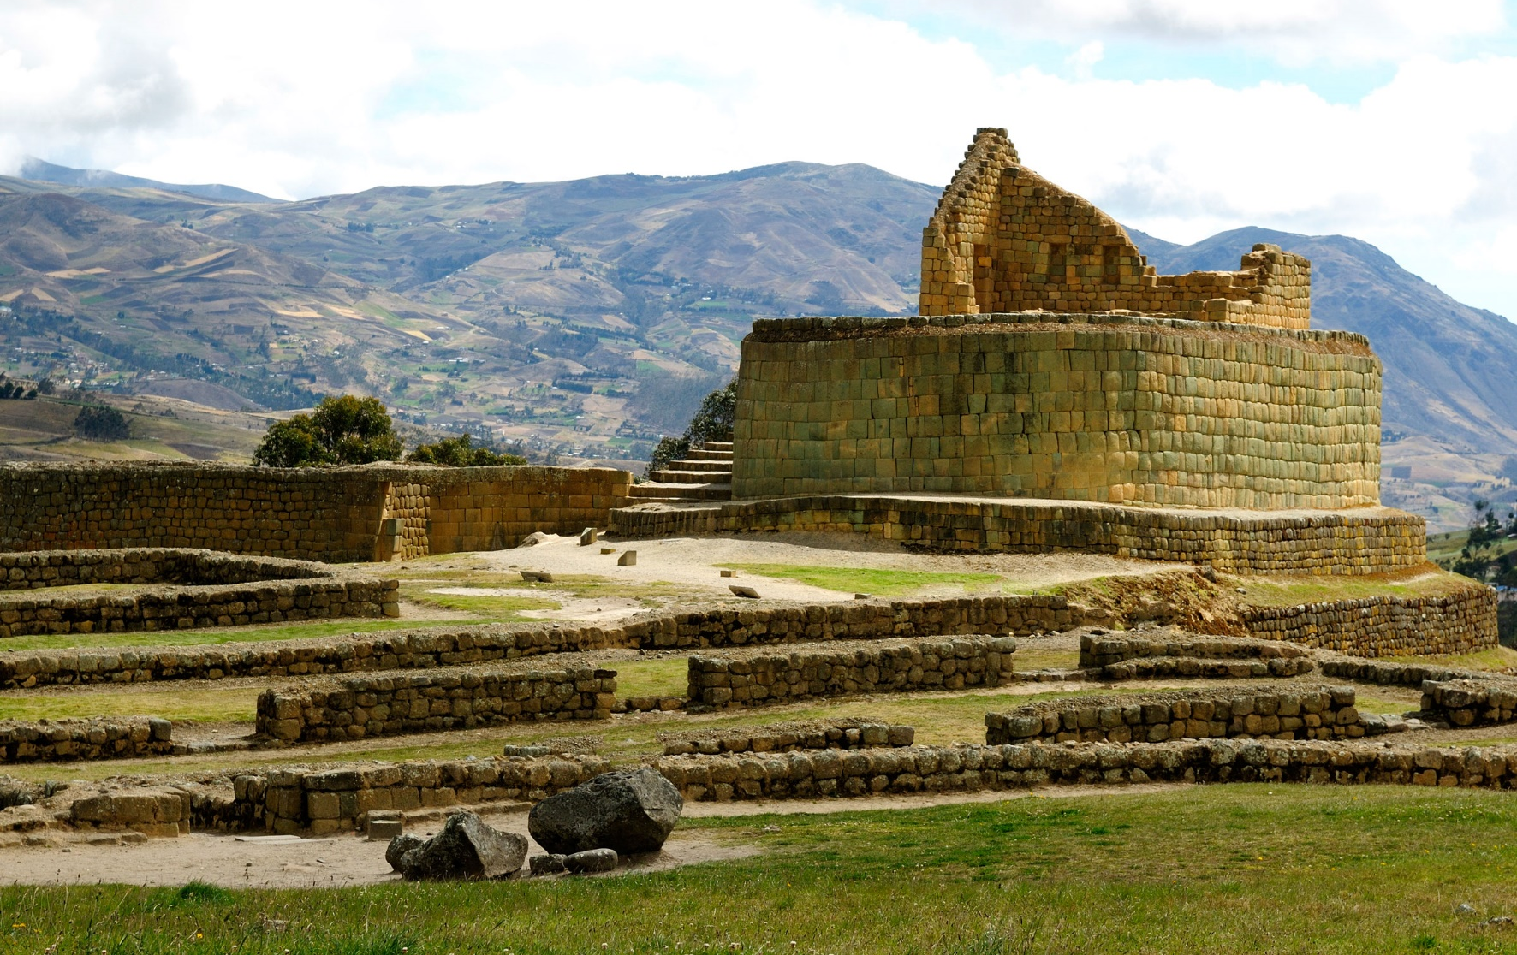
Ingapirca
Largest Incan Ruins

Slide 16
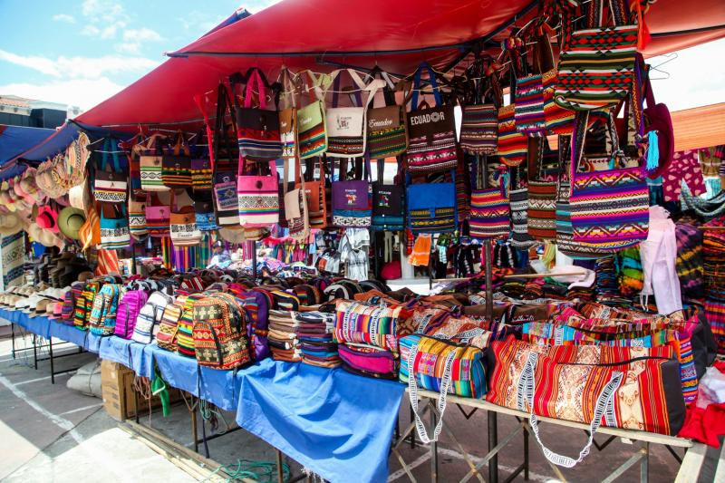
Largest Market
OTAVALO

Slide 17
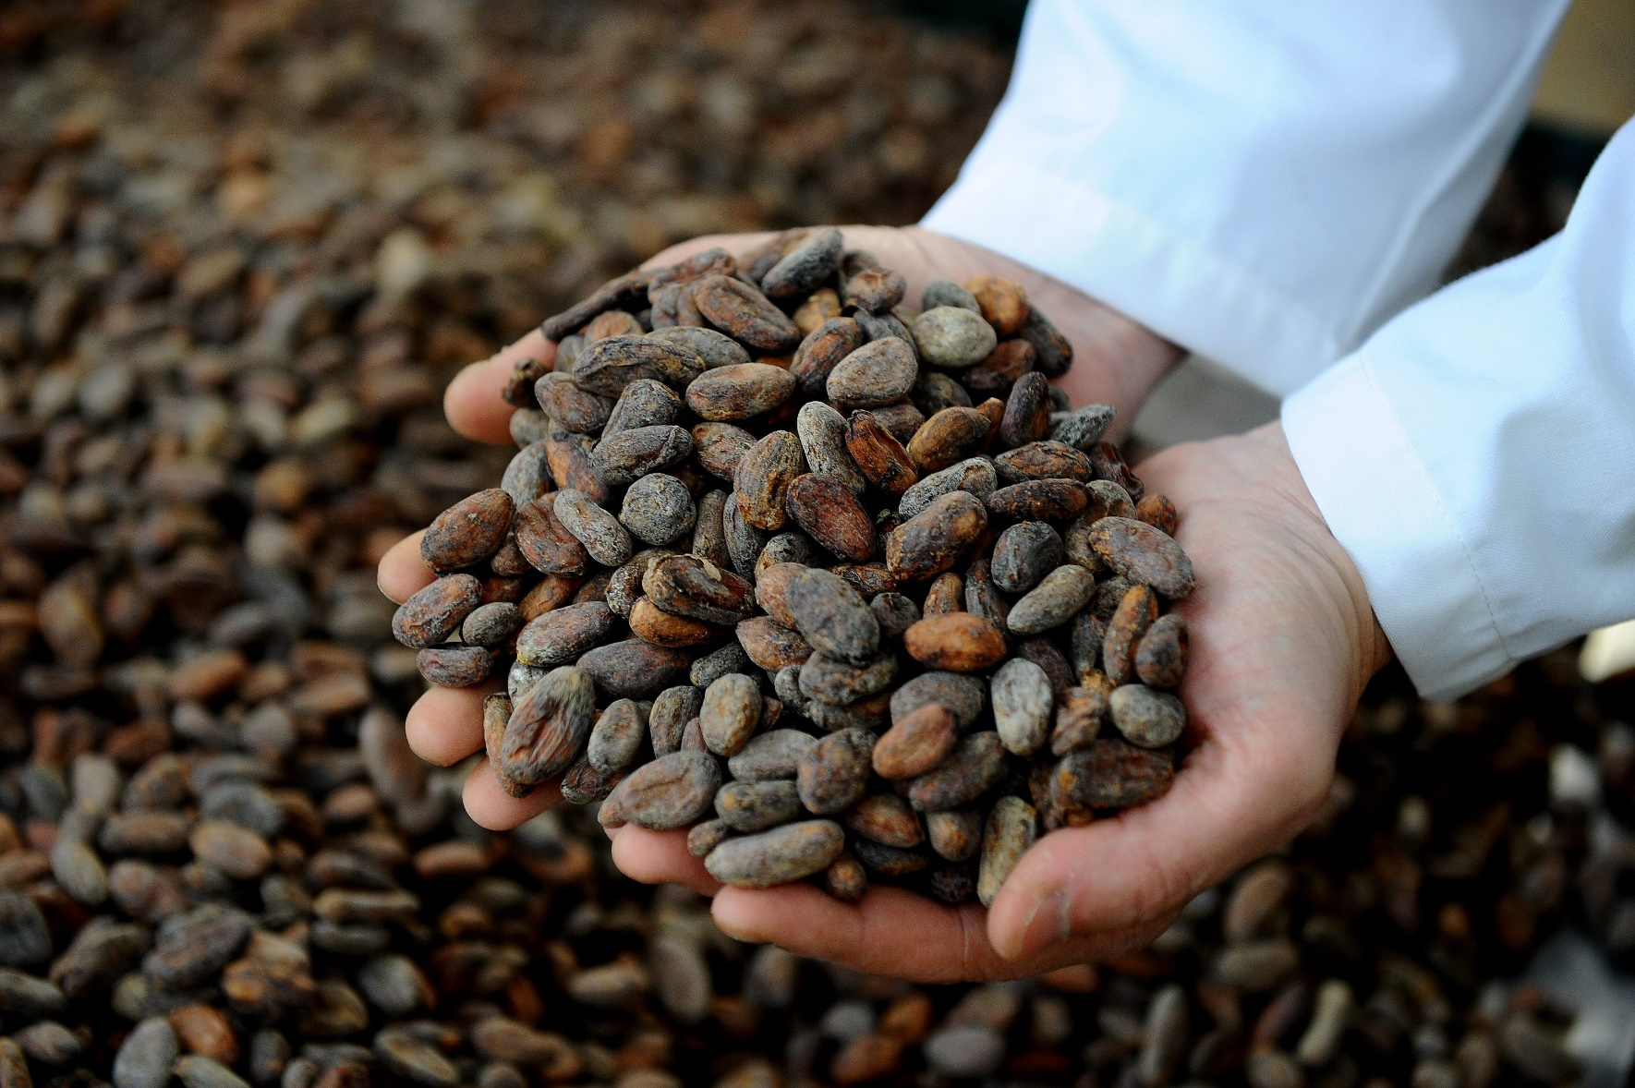
Black Gold:
Chocolate
(Cacao)

Slide 18
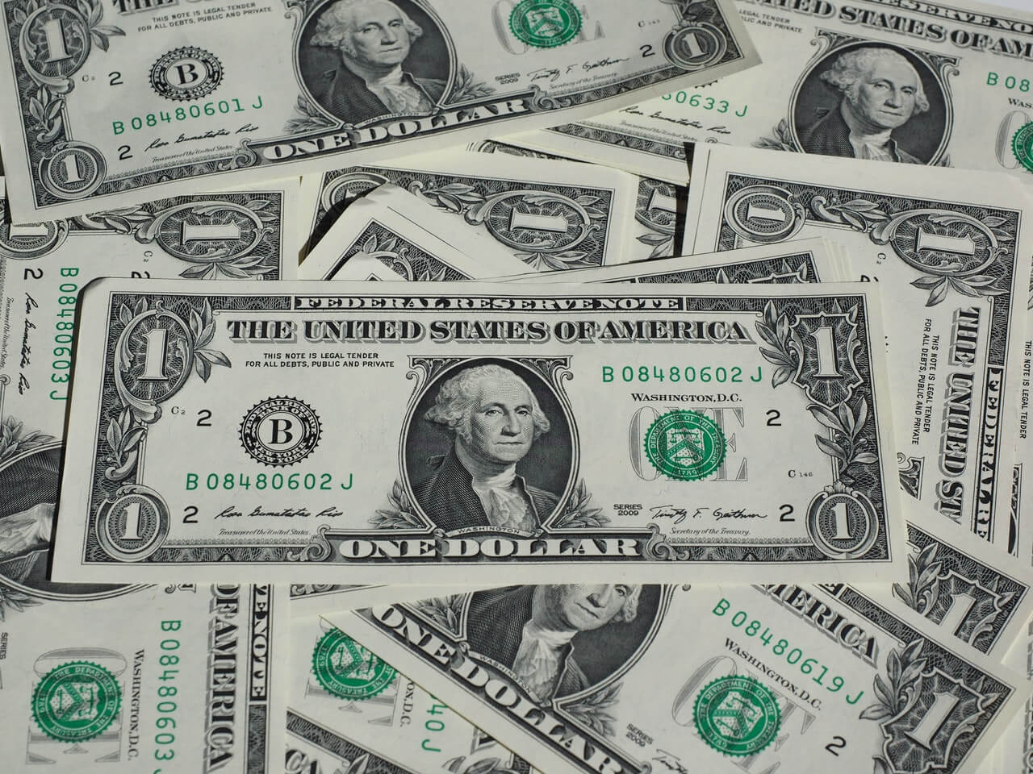
Currency:
U.S. Dollar

Slide 19
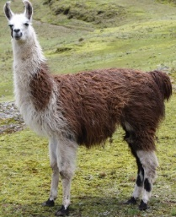
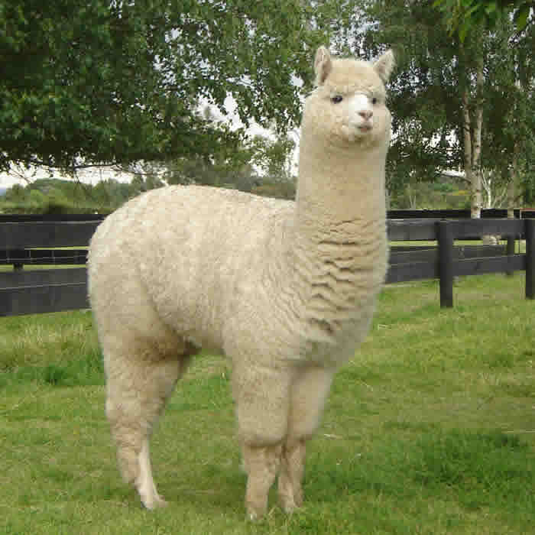
Wool:
Alpaca
Llama

Slide 20
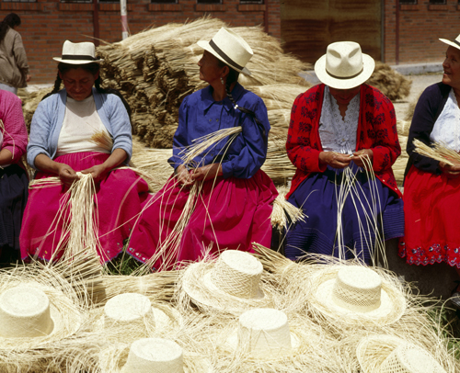
Hat:
Panama

Slide 21
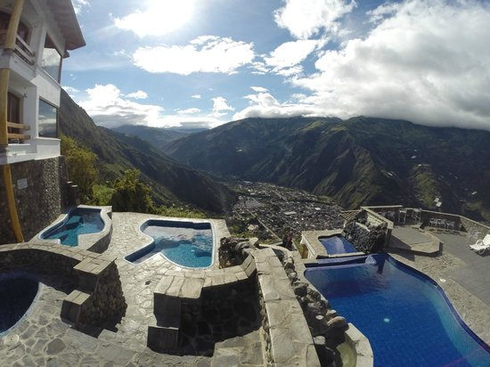
Thermal springs in Baños heated by
Volcanos

